Slide 1
Cascading Style Sheets

Slide 2
What is CSS?
CSS stands for Cascading Style Sheets
CSS defines how HTML elements are to be displayed
CSS saves a lot of work

Slide 3
CSS How To...
There are three ways of inserting a style sheet:
External style sheet
Internal style sheet
Inline style

Slide 4
Inline style
To use inline styles, add the style attribute to the relevant tag.
The style attribute can contain any CSS property.

Slide 5
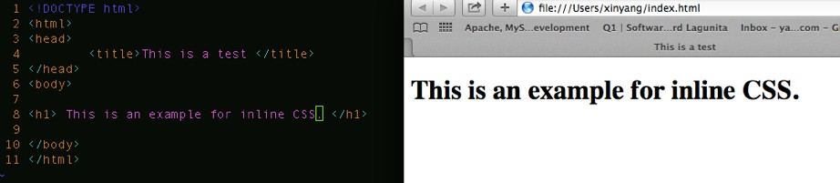
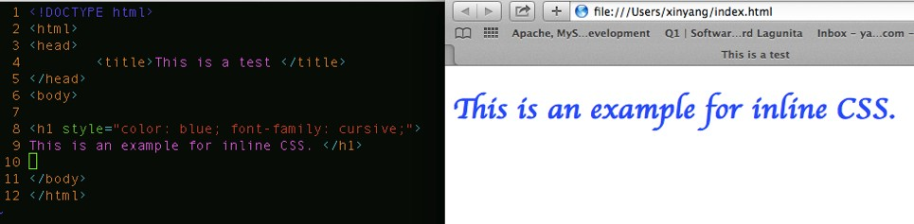
Inline style
The example shows how to change the color and the font family of a h1 element:

Slide 6
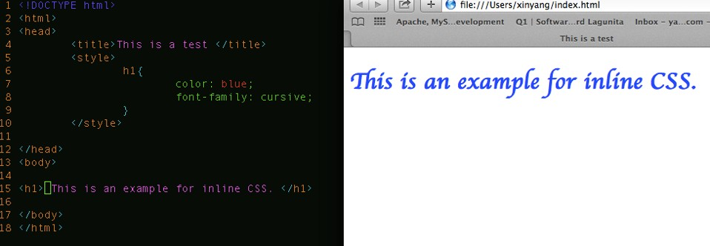
Internal Style Sheet
An internal style sheet should be used when a single document has a unique style. You define internal styles in the head section of an HTML page, inside the <style> tag, like this:

Slide 7
External Style Sheet
An external style sheet is ideal when the style is applied to many pages.
With an external style sheet, you can change the look of an entire Web site by changing just one file.
Each page must include a link to the style sheet with the <link> tag.
The <link> tag goes inside the head section

Slide 8
External Style Sheet
Your <link> tag needs three attributes:
A type attribute that should always be equal to: “text/css”
A rel attribute that should always be equal to : “stylesheet”
A href attribute that should point to the web address of your CSS file

Slide 9

External Style Sheet
Your <link> tag needs three attributes:

Slide 10
External CSS file
An external style sheet can be written in any text editor.
The file should not contain any html tags.
The style sheet file must be saved with a .css extension

Slide 11
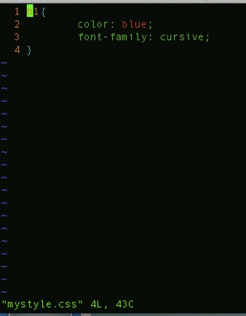
CSS file

Slide 12
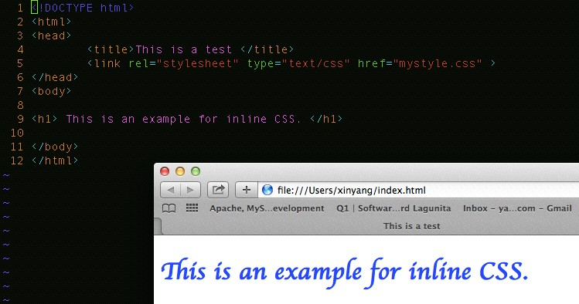
External Style Sheet

Slide 13
CSS Syntax

Slide 14

CSS Syntax
A CSS rule set consists of a selector and a declaration block:
The selector points to the HTML element you want to style
The declaration block contains one or more declarations separated by semicolons.
Each declaration includes a property name and a value, separated by a colon

Slide 15

CSS Example
A CSS declaration always ends with a semicolon, and declaration groups are surrounded by curly braces:
To make the CSS code more readable, you can put one declaration on each line.

Slide 16
CSS id Selector
The id selector uses the id attribute of an HTML element to select a specific element.
An id should be unique within a page, so the id selector is used if you want to select a single, unique element.
To select an element with a specific id, write a hash character, followed by the id of the element.

Slide 17
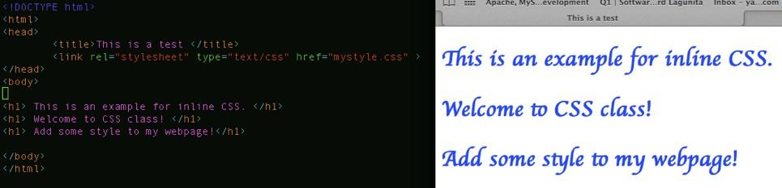
CSS id Selector

Slide 18
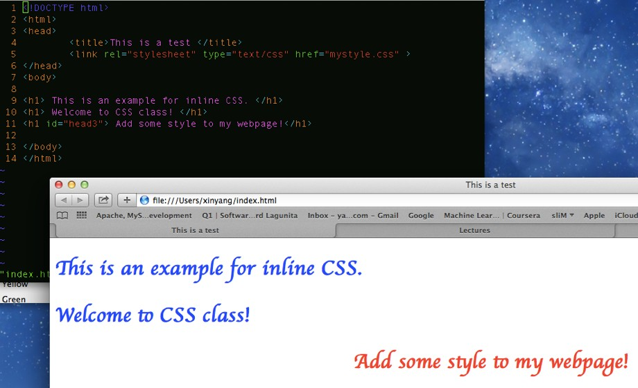
CSS id Selector

Slide 19
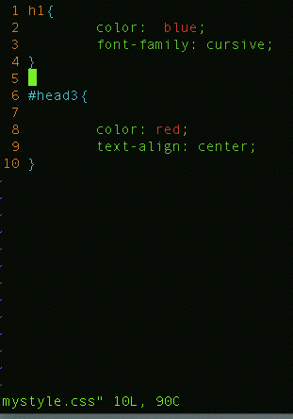
CSS id Selector

Slide 20
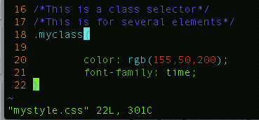
CSS class Selector
The class selector selects elements with a specific class attribute.
To select elements with a specific class, write a period character, followed by the name of the class

Slide 21
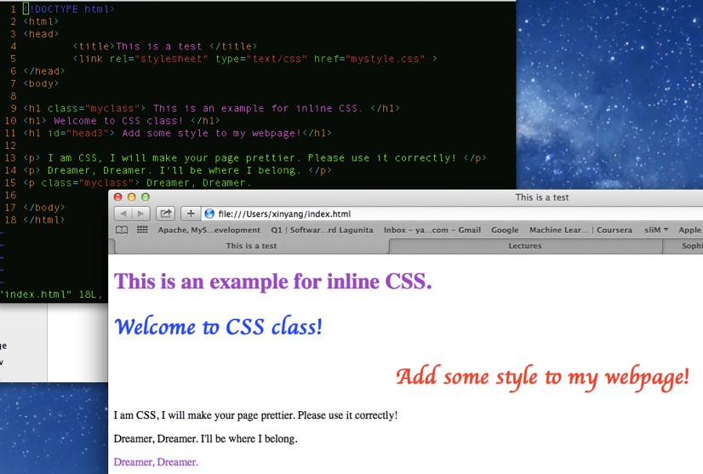
CSS class Selector

Slide 22
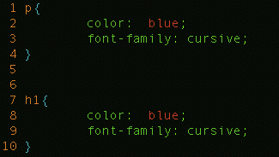
CSS group Selector
If you have elements with the same style definitions, like this:

Slide 23
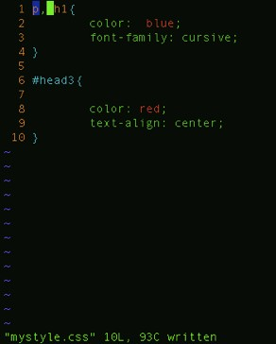
CSS group Selector
you can group the selectors, to minimize the code.
To group selectors, separate each selector with a comma.

Slide 24
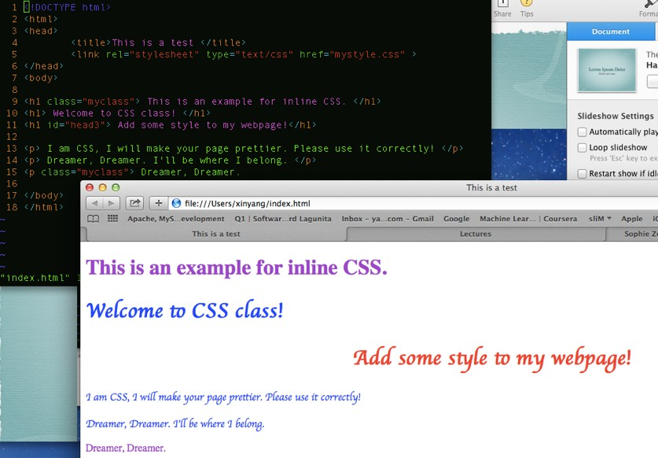
CSS group Selector

Slide 25
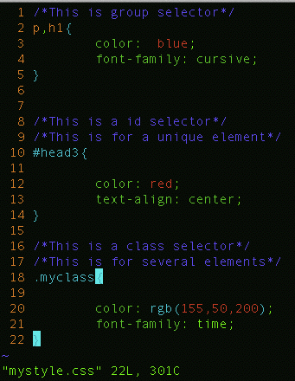
Summary

Slide 26
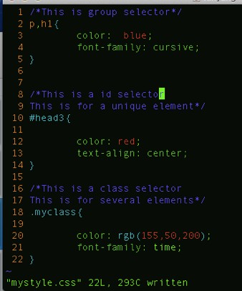
CSS Comment
Comments are used to explain your code, and may help you when you edit the source code at a later date.
Comments are ignored by browsers.
A CSS comment starts with /* and ends with */. Comments can also span multiple lines:

Slide 27
CSS Background

Slide 28
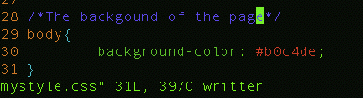
Background Color
The background-color property specifies the background color of an element.The background color of a page is set like this:
With CSS, a color is most often specified by:
a HEX value - like “#ff0000"
an RGB value - like “rgb(255,0,0)"
a color name - like "red"

Slide 29

Background Color

Slide 30
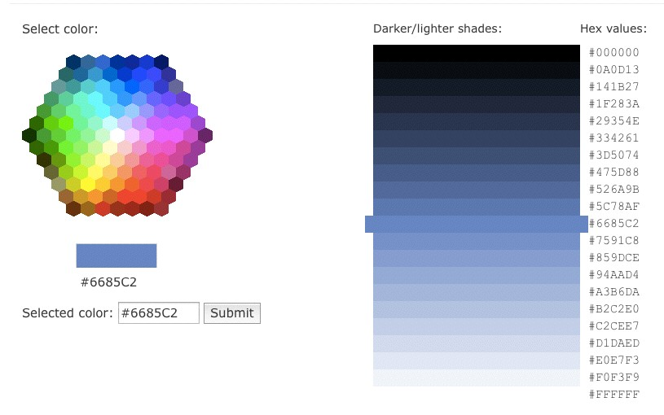
Color Picker

Slide 31
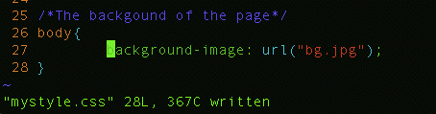
Background Image
The background-image property specifies an image to use as the background of an element.
By default, the image is repeated so it covers the entire element.The background image for a page can be set like this:

Slide 32

Background Image

Slide 33


Background Image

Slide 34
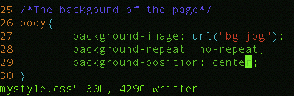

Background Image position

Slide 35
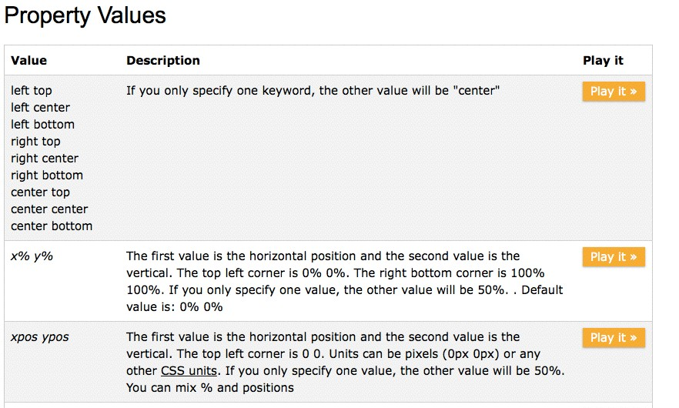
Background Image position

